Slide 1


Interruptions in HCI and Boundary Management

Slide 2
Structure
Relevance
Definitions (Interruptions, Multitasking etc.)
Interruptions and their repercussions
Effects on Productivity
Effects on emotional condition (Focus: Stress)
Conclusions for Boundary Management
Characteristics of Boundaries
Cross-Boundary Interruptions and specific effects
Coping Strategies
Further Research Questions

Slide 3
Structure
Relevance
Definitions (Interruptions, Multitasking etc.)
Interruptions and their repercussions
Effects on Productivity
Effects on emotional condition (Focus: Stress)
Conclusions for Boundary Management
Characteristics of Boundaries
Cross-Boundary Interruptions and specific effects
Coping Strategies
Further Research Questions

Slide 4
1. Relevance
Amount of Interruptions is on the rise
This is the case for every daily life situation
Peoples Behavior is affected
Various studies suggest a link between interruptions and (mostly negative) psychological effects

Slide 5
Structure
Relevance
Definitions (Interruptions, Multitasking etc.)
Interruptions and their repercussions
Effects on Productivity
Effects on emotional condition (Focus: Stress)
Conclusions for Boundary Management
Characteristics of Boundaries
Cross-Boundary Interruptions and specific effects
Coping Strategies
Further Research Questions

Slide 6
2.1 What is an Interruption?
Few formal definitons
Boehm-Davis and Remington: An Interruption is "the suspension of one stream of work prior to completion, with the intent of returning to and completing the original stream of work“
The Presence of the first task which is interrupted by a second task is an important characteristic

Slide 7

2.2 Human Multitasking
Leonardo da Vinci
1452 - 1519

Slide 8
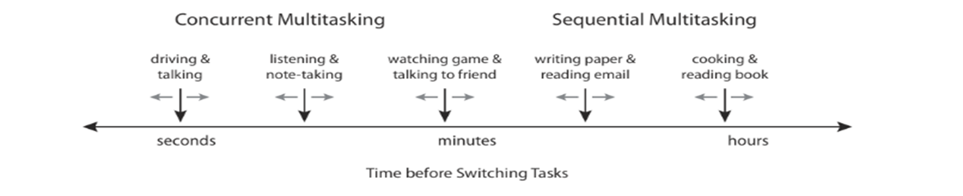
2.2 Human Multitasking (Cont‘d)
Ability to perform more than one task at a time
Two kinds of multitasking: Sequential and Concurrent Multitasking

Slide 9
“It usually involves skimming the surface of the incoming data, picking out the relevant details, and moving on to the next stream. You’re paying attention, but only partially. That lets you cast a wider net, but it also runs the risk of keeping you from really studying the fish.“ - Steven Berlin Johnson (*1968)

Slide 10
Structure
Relevance
Definitions (Interruptions, Multitasking etc.)
Interruptions and their repercussions
Effects on Productivity
Effects on emotional condition (Focus: Stress)
Conclusions for Boundary Management
Characteristics of Boundaries
Cross-Boundary Interruptions and specific effects
Coping Strategies
Further Research Questions

Slide 11
3. Humans Limited Cognitive Abilities
A vast amount of studies were made to investigate the effects of multitasking and interrupted tasks for the brain
The results are often contradictory but most scientists agree: We are bad at doing several things at a time
This problem is becoming more and more serious due to increasing demands and stagnating capacities

Slide 12
3. The Zeigarnik Effect
One of the first studies about interruption and how people deal with them
Conducted in 1927 by the russian psychologist Bljuma Wulfowna Zeigarnik
Unexpected result: People remember interrupted tasks better than completed
Possible Explanation: certain tasks produce a specific tension to complete them and an interruption avert this tension to reduce
BUT: the reproduction of this effect failed several times
Notes:
Versuchsaufbau: verschiedene einfache Aufgaben wie z.B. ein Gedicht aufschreiben, eine Figur aus Knetgummi herstellen, Perlen auf einen Faden aufziehen … insgesamt 43 solcher trivialen Aufgaben.
Frage: sind Unterbrechungen vielleicht sogar ein Performanceverbesserer? Eher schwierig, siehe letzter Punkt

Slide 13
3. Effects of Interruptions in HCI
Quality of Tasks
→ Are there significant changes in time of completion and quality of results?
Emotional condition
→ Do people suffer in an interruption-loaded environment and which kind of problems may occur?

Slide 14
Structure
Relevance
Definitions (Interruptions, Multitasking etc.)
Interruptions and their repercussions
Effects on Productivity
Effects on emotional condition (Focus: Stress)
Conclusions for Boundary Management
Characteristics of Boundaries
Cross-Boundary Interruptions and specific effects
Coping Strategies
Further Research Questions

Slide 15


Slide 16
3.1 Effects on Productivity
Economic impact of Interruptions were estimated to be around 588 bn $ p.a in the US (2005).
This suggests that interruptions are disruptive and should be avoided
BUT: there are some characteristics of interruptions which contribute to their disruptive impact

Slide 17
3.1 Effects on Productivity (Cont‘d)
These characteritics are:
interruption complexity
similarity of interruption task and primary task
task phase in which the interruption occur
control over interruption engagement

Slide 18
Structure
Relevance
Definitions (Interruptions, Multitasking etc.)
Interruptions and their repercussions
Effects on Productivity
Effects on emotional condition (Focus: Stress)
Conclusions for Boundary Management
Characteristics of Boundaries
Cross-Boundary Interruptions and specific effects
Coping Strategies
Further Research Questions

Slide 19

3.2. Effects on Emotional Condition

Slide 20
3.2.1 Some more Definitions
Stress: A state of mental or emotional strain or tension resulting from adverse or demanding circumstances.
Distress: negative Stress often accompanied with a feeling of helplessness and excessive demand
Eustress: positive Stress in a demanding but manageable situation
Anxiety: A feeling of worry, nervousness, or unease about something with an uncertain outcome. Often accompanied by nervous behaviour
Concentration: The action or power of focusing all one's attention.

Slide 21
3.2.2 Interruptions and Stress
Inital Question: do interruptions contribute to an increase in the perceived stress level?
Which kind of stress does occur?
3 Studys and their key findings will be presented to show the connections between them

Slide 22
3.2.2.1 Interruptions and Stress: Study 1
Study conducted in 2008 by Mark, Gudith and Klocke
Focus on Interruption context and anticipation opportunities
84 participants in a laboratory study
Setup: Office-like environment with several e-mail tasks and social interruptions via telephone or IM

Slide 23
3.2.2.1 Interruptions and Stress: Study 1
Key findings:
→ Interruption of tasks led to an increased working speed
Context doesn‘t matter as much as commonly assumed
Anticipation opportunities highly contribute to wellbeing
Most Important: even short working times (~20 minutes) in an interruption-loaded environment increased the stress level tremendously
Notes:
Erklärung: Zirkelschluss zum Zeigarnik effect. Unerledigte Aufgabe erzeugen eine inner tension, welche zum starken Drang der Vervollständigung führen und deswegen druck aufbauen welcher zu stress führt

Slide 24
3.2.2.2 Interruptions and Stress: Study 2
Study conducted in 2009 by Carton and Aiello
Focus on Interruption anticipation and prevention
74 participants in a laboratory study
Setup: simple word finding tasks with time limitation
4 Groups:
Control / Anticaption | No Control /Anticipation
Control / No Anticipation | No Control / No Anticipation
Notes:
Control: Möglichkeit Unterbrechungen abzuwenden
Anticipation: Bescheid wissen, dass Unterbrechungen stattfinden werden

Slide 25


3.2.2.2 Interruptions and Stress: Study 2
3 Hypothesis
Hypothesis | Result
H1. Greater ability to anticipate social interruptions will result in improved task performance.
H2. Greater perceived ability to control the environment will result in improved task performance.
H3. Greater perceived ability to control social interruptions will result in reduced stress.

Slide 26
3.2.2.3 Interruptions and Stress: Study 3
Survey made by Barsties in 2011
Focus on negative stress, concentration and mental turmoil
136 participants (only students)
The interruption load has been determined by the frequency of use of instant messaging services

Slide 27
3.2.2.3 Interruptions and Stress: Study 3
6 Hypotheses:
Hypotheses | Result
H1.1 IM-user perceive more stress than non-user
H1.2 IM-user are less able to focus on something
H1.3 IM-user experience increased mental turmoil
H2.1 The more IM-Services are used, the higher the perceived stress level
H2.2 Concentration ability declines with rising IM-use
H2.3 Mental turmoil increasis with rising IM-use
Notes:
Messung von Stress via Trierer Inventar zum chronischen Stress (Schulz et. al 2006)
Messung von Konzentration via KIA (Scholz 2006)
Messung von mentaler Unruhe (Barsties 2011)

Slide 28
3.2.2.4 Interruptions and Stress: Conclusions
In most cases Interruptions impair the emotional condition of an individual
But there are factors that contribute more than others
Context doesn‘t matter as much as commonly thought
Interrupted tasks can build a „tension of completion“ which increases the stress-level
Interruptions that are perceived negatively have a more disruptive effect

Slide 29
Structure
Relevance
Definitions (Interruptions, Multitasking etc.)
Interruptions and their repercussions
Effects on Productivity
Effects on emotional condition (Focus: Stress)
Conclusions for Boundary Management
Characteristics of Boundaries
Cross-Boundary Interruptions and specific effects
Coping Strategies
Further Research Questions

Slide 30

4. Conclusions for Boundary Management

Slide 31





4.1 Characteristics of Boundaries
Ashforth: „The physical, temporal, emotional, cognitive, and/or relational limits that define entities as separate from one another “
Domains often merge
Interruptions are the “gate” for one Domain into another

Slide 32
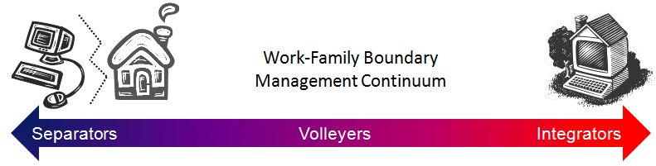
4.2 Cross Boundary Interruptions
Interruptions can be seen as overlapping domains for a short period of time („Micro Crossing“)
How people cope with „Micro Crossing“ relies on how they manage their domains in general
Notes:
Menschen, welche ihre domains stärker ineinander verflochten haben Integrators werden von Interruptions nicht so leicht in ihrem workflow beinträchtigt, da sie das ineinandergreifen von verscheidenen domains gewohnt sind und damit umgehen können. Seperators sind gegenüber solchen situationen eher avers.

Slide 33
Structure
Relevance
Definitions (Interruptions, Multitasking etc.)
Interruptions and their repercussions
Effects on Productivity
Effects on emotional condition (Focus: Stress)
Conclusions for Boundary Management
Characteristics of Boundaries
Cross-Boundary Interruptions and specific effects
Coping Strategies
Further Research Questions

Slide 34
5. Coping Strategies
Short strategies for coping with interruptions in every day live
Know your need of domain-segmentation
Identify tasks which should not be interrupted and use tools to prevent them
Interruptions don‘t have to be disruptive
Notes:
Manche leute haben nicht so großen bedarf an segmentation wie andere. Vielen ist es zb unangenehm in verschiedenen kontexten kontaktiert zu werden zb zuhase vom chef

Slide 35
Structure
Relevance
Definitions (Interruptions, Multitasking etc.)
Interruptions and their repercussions
Effects on Productivity
Effects on emotional condition (Focus: Stress)
Conclusions for Boundary Management
Characteristics of Boundaries
Cross-Boundary Interruptions and specific effects
Coping Strategies
Further Research Questions

Slide 36

6. Further Research Questions

Slide 37



6.1 Direction of Interruptions
Do interruptions from different sources have different effects?

Slide 38
6.2 Types of Concentration
Concentration
→ Ability of focussing in a work-related context
Perception
→ Ability of conscious observing in a not task-related environment
Do Interruptions affect both of these abilities in the same way?

Slide 39
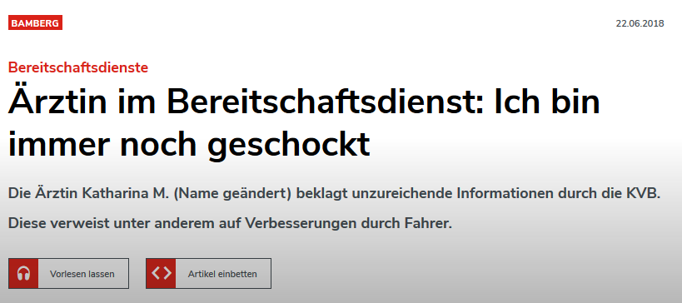
Source: https://www.infranken.de/regional/bamberg/aerztin-im-bereitschaftsdienst-ich-bin-immer-noch-geschockt;art212,3487654
Notes:
KVB = Kassenärztliche Vereinigung Bayerns multiple colleagues had cancelled their on-call service before her driving around for 7 hours in night, many cases that were not as critical
Ashamed, guilty, wants to stay anonymous

Slide 40
Failure in on-call service
Excessive Workload
No prioritization of emergency calls
Consequences with maximum severity

Slide 41
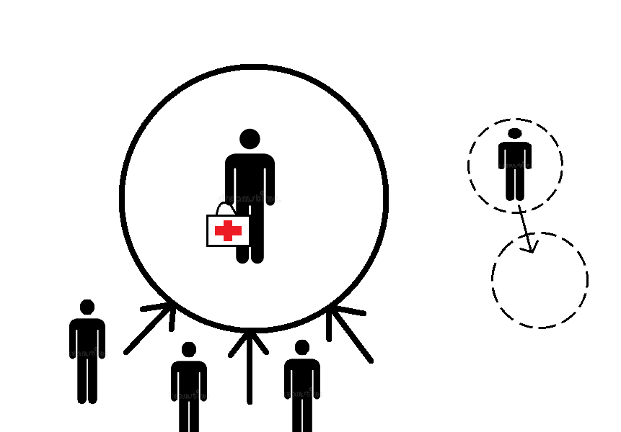
On-call service as a Domain with a strong boundary
Notes:
Segmenting by force, no integration
Arrows symbolize social pressure, consequences
Boundary flexibility is minimal
Boundary permeability is low (physical vicinity necessary to reach patients fast)

Slide 42
Boundary attributes
Minimal boundary flexibility (defined by [Piszczeket al., 2014])
High boundary permeability (defined by [Hecht et al., 2009])
→ Boundary thickness debatable (defined by [Ashforth et al., 2000])
Notes:
Seminar has progressed, like to refer to earlier topics and provide context
Boundary flexibility: “Capacity of the boundary to be moved temporally or physically.”
Boundary permeability: „Reflects the extent to which an individual might be psychologically and/or behaviorally engaged in one domain, while physically located in another, or at times that are traditionally devoted to the other.“
Permeability is high because of feeling of responsibility or guilt, traumatic shocking images that are being remembered, might need to provide medical service when not in work
Boundary thickness: „Boundaries between life spheres differ in thickness depending on their permeability and flexibility.“

Slide 43
Effects on doctors
Questionnaires in 2006 and 2010 among physicians in Finland
1541 respondents
Results: Sleeping problems and WIF lead to high distress, low job satisfaction, low work ability
Number of active on-call hours is associated with higher levels of WIF, but not sleeping problems
Notes:
WIF = work interference with family
Conclusion: According to our results, one way to attenuate on-call work’s negative ramifications is to make it easier for on-call physicians to connect work and family lives and develop work arrangements to promote better sleep and protected sleep time

Slide 44
Mental, cognitive, behavioural symptoms
Symptom | On-call % | On-vacation %
Tearfulness, depression | 23,2 | 3,3
Memory disturbances | 45,8 | 9,5
Need for alcohol | 30,5 | 18,4
Need for sleeping medicine | 15,8 | 5,0
Bulimia | 16,2 | 6,0
Lindfors et al., 2006
Notes:
On-call stress among Finnish anaesthetists
Other symptoms: feeling guilty, anxiety, nightmares, self destructiveness

Slide 45
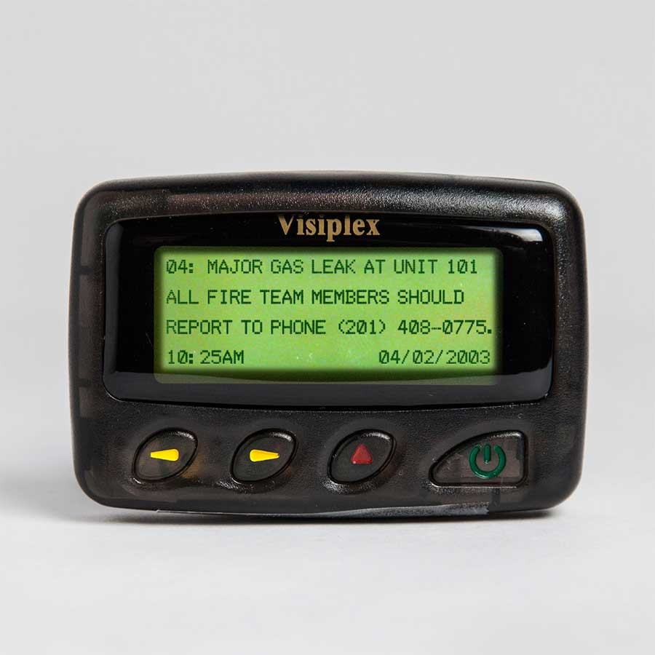
How paging technology enables high availability
Minimal complexity, dedicated task
Increased broadcast power
Signals good at penetrating buildings, are being combined for better reception
Batteries last weeks
Disaster-proven
Source: https://www.visiplex.com/product/alphanumeric-pager/
Notes:
Increased broadcast power -> fewer towers needed, storm damage less likely
Cellphone towers can either blackout in disasters or be overloaded
Minimal complexity means minimal interruptions

Slide 46
Why does it matter?
Still in heavy use
Trade-off between complexity and reliability
Trade-off between point-to-point and broadcast
Notes:
Heavy use despite reports of being replaced
Trade-offs are fundamental and timeless and decide over availability and interruptions

Slide 47
How does high availability relate to interruptibility?

Slide 48
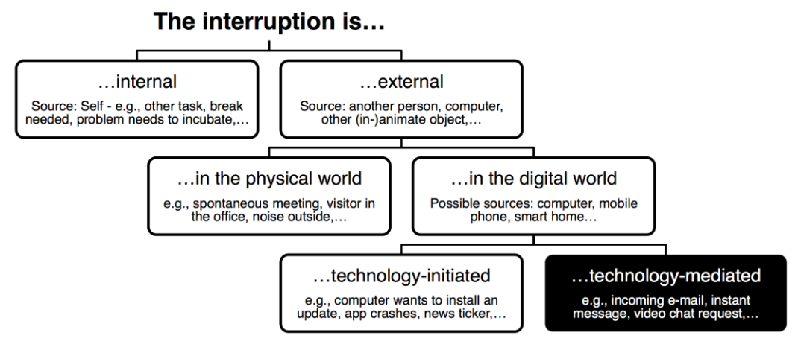
Availability and Interruptability
Source: [Fetter et al., 2018]
Notes:
CMC = Computer-mediated Communication
Categorise source and nature of interruption
Thereby exterNal interruptions result “from events in the environment” whereby internal interruptions come “from our own thought processes
—
new ideas that draw attention from the current activity.”
(Miyata & Norman 1986, p. 268)
Digital: interruption is
“an event within the notification system prompting transition of
attention focus from a primary task to a notification”
(McCrickard
et al. 2003, pp. 551)
Technology-mediated interruptions maximize availability

Slide 49
Signalling availability
Bias: Unavailability is being signalled
Signalling availability instead as a chance to give positive reinforcement to social environment
Potentially improved job satisfaction
Notes:
Unavail. Bias also when developing sensors: capture voice activity, analyse calendar entries
Signaling avail. = positive – Signalling unavail. = negative, frustrating
Bias also in apps: Do-not-disturb, blocking, muting, disabling read confirmation

Slide 50
Deceit in signalling unavailability
[Birnholtz et al. 2010]: Butler lies
Temporal ambiguity
Activity ambiguity
Giving multiple options
Further strengthens negative association with unavailability
Notes:
Participants: 194 US students
Term alludes to role the butlers used to play for their employers
Temporal ambiguity: sorry I just saw your text
Activity ambiguity: Eating now, can I call you later? Delays the conversation
Location ambiguity: I‘m almost there!
Giving multiple options: Not sure if go to this place or the other

Slide 51
Sources
Boehm-Davis, Deborah A.; Remington, Roger (September 2009). "Reducing the disruptive effects of interruption: A cognitive framework for analysing the costs and benefits of intervention strategies". Accident Analysis & Prevention. 41 (5): 1124–1129. doi:10.1016/j.aap.2009.06.029 (what is interruption?)
Salvucci, D. D., Taatgen, N. A., & Borst, J. P. (2009, April). Toward a unified theory of the multitasking continuum: From concurrent performance to task switching, interruption, and resumption. In Proceedings of the SIGCHI conference on human factors in computing systems (pp. 1819-1828). ACM. (multi)
Everything Bad Is Good for You: How Today's Popular Culture Is Actually Making Us Smarter by Steven Berlin Johnson, p.61 (fish quote)
Zeigarnik, B. (1927). Das Behalten erledigter und unerledigter Handlungen. Psychologische Forschung, 9, 1-85 (Zeigarnik Effect)
Spira, J. B., & Feintuch, J. B. (2005). The cost of not paying attention: How interruptions impact knowledge worker productivity. Report from Basex. (Effect Qu)
Zijlstra, F. R., Roe, R. A., Leonora, A. B., & Krediet, I. (1999). Temporal factors in mental work: Effects of interrupted activities. Journal of Occupational and Organizational Psychology, 72(2), 163-185. (Effect Quality Interruption Complexity)
Oulasvirta, A., & Saariluoma, P. (2004). Long-term working memory and interrupting messages in human–computer interaction. Behaviour & Information Technology, 23(1), 53-64. (Effect Quality Similarity)

Slide 52
Sources (Cont‘d)
Horvitz, E. C. M. C. E. (2001). Notification, disruption, and memory: Effects of messaging interruptions on memory and performance. In Human-computer Interaction: INTERACT'01: IFIP TC. 13 International Conference on Human-Comupter Interaction, 9th-13th July 2001, Tokyo, Japan (p. 263). IOS Press. (Effect Quality Task Phase)
http://www.zeno.org/Kunstwerke/B/Leonardo+da+Vinci%3A+Selbstportr%C3%A4t(da vinci)
Le Fevre, M., Matheny, J., & Kolt, G. S. (2003). Eustress, distress, and interpretation in occupational stress. Journal of Managerial psychology, 18(7), 726-744. (Stress Defintion)
Mark, G., Gudith, D., & Klocke, U. (2008, April). The cost of interrupted work: more speed and stress. In Proceedings of the SIGCHI conference on Human Factors in Computing Systems (pp. 107-110). ACM. (Study 1)
Carton, A. M., & Aiello, J. R. (2009). Control and anticipation of social interruptions: Reduced stress and improved task performance. Journal of Applied Social Psychology, 39(1), 169-185. (Study 2)
Barsties, M. L. (2011). Text-und bildbasierte Kommunikation auf Smartphones. Auswirkungen im Hinblick auf Distress, Konzentration und mentale Unruhe (Stress Study 3)
Scholz, A. (2006). Konzentration im Alltag: Erleben und Leistung. (Concentration)
Ashforth, B. E., Kreiner, G. E., & Fugate, M. (2000). All in a day's work: Boundaries and micro role transitions. Academy of Management review, 25(3), 472-491. (Boundary Characteristics)
Kossek, E. E., & Lautsch, B. A. (2008). CEO of me: Creating a life that works in the flexible job age. Pearson Prentice Hall. (Boundary Crossing Interruptions)

Slide 53
Sources (Cont‘d)
Heponiemi, T., Puttonen, S., Elovainio, M. (2014). On-call work and physicians’ well-being: testing the potential mediators. Occupational Medicine, 64, 352-357.
Lindfors, P.M., Nurmi, K. E., Meretoja, O. A., Luukkonen, R. A., Viljanen, A.-M., Leino, T. J., Härmä, M I. (2006). On-call stress among Finnish anaesthetists. Anaesthesia, 61, 856-866.
Holten Møller, N. L. (2013). Achieving Continuity of Care: A Study of the Challenges in a Danish and a US Hospital Department. ECSCW 2013: Proceedings of the 13th European Conference on Computer Supported Cooperative Work, 229-247.
Fetter, M., Müller, A.-L., Vasilyev, P., Barth, L. M., Gross, T., (2018). Towards a Better Understanding of Availability and Interruptibility with Mobile Availibility Probes. Reports of the European Society for Socially Embedded Technologies: vol. 2, no. 1.
Birnholtz, J., Guillory, J., Hancock, J. and Bazarova, N. (2010). "on My Way": Deceptive Texting and Interpersonal Awareness Narratives. In Proceedings of the ACM Conference on Computer-Supported Cooperative Work - CSCW 2010 (Feb. 6-10, Savannah, GA, USA). ACM Press, New York, NY, USA. pp. 1-4.
https://www.infranken.de/regional/bamberg/aerztin-im-bereitschaftsdienst-ich-bin-immer-noch-geschockt;art212,3487654
https://www.visiplex.com/product/alphanumeric-pager/

